Slide 1
The Temple of Claudius
Matilda Hamilton

Slide 2
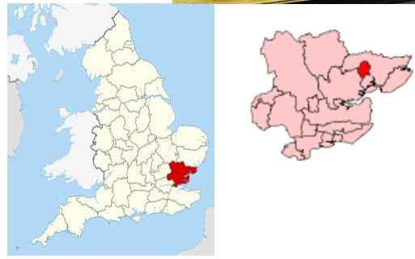
Where was the Temple of Claudius
The Temple of Claudius was in a place called Camulodunum
Camulodunum is the Roman name for Colchester
Colchester is in Essex, England
Colchester was the first and most important Roman colony in Britain

Slide 3
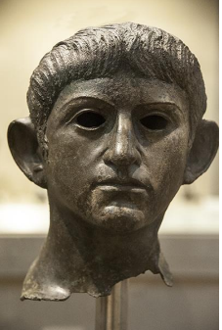
Emperor Claudius
Claudius was a Roman emperor
He was the emperor of Rome when they invaded England
Claudius died in about 54 AD (that means 54 years after Jesus was born)
The Romans built a temple for Claudius to remember him
This is a statue of Claudius in the British Museum

Slide 4
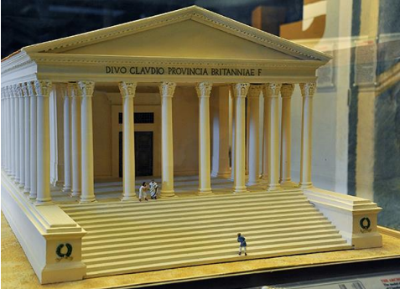
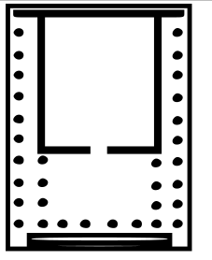
The Temple of Claudius
A temple was built in Camulodunum for Claudius
The Temple is not there anymore but the pictures show what it might have looked like
The plan is what the building would look like if you were in the sky looking down, spots on the plan show where there were columns
Lots of Roman buildings had columns like these
Main temple
Columns
Steps

Slide 5
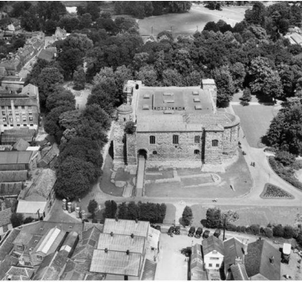
From a Temple to a Castle
The Roman Temple isn’t there anymore
Now there is a Castle at Colchester where the Temple of Claudius used to be
I think I can still see some of the ruins of the old temple
I am looking forward to searching for them on our class trip!

