Slide 1
This is Hadrian’s Wall
By Molly Davidson

Slide 2
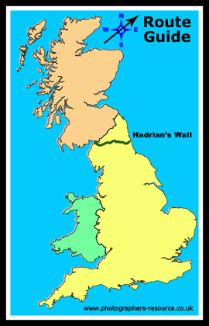
Hadrian’s Wall
Hadrian was the roman emperor from 117 to 138 A.D
In 122 A.D he begun to build the wall
The wall runs the whole way across the land that is now northern England
Hadrian built the wall to keep enemies out of Roman empire
The wall was 73 miles long but in roman miles 80
It took 15,000 soldiers to build Hadrian’s Wall
It was around 12 FT high and 8 FT wide
It only took 6 years to build

Slide 3
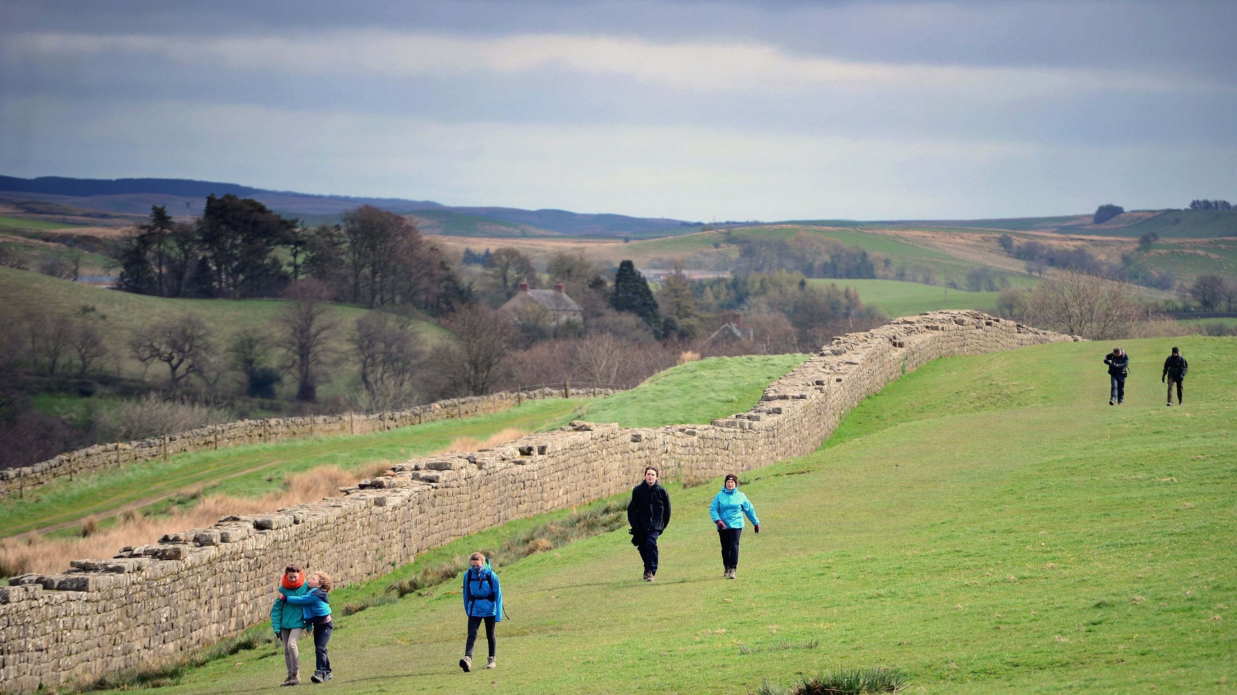
Hadrian’s Wall
Hadrian died in 138 A.D at the age of 62
The new Emperor was very rude to abandon the wall
So he decided to build himself his own wall which was to the north
When the romans left Britain in 410 A.D the wall fell into ruin
People took rocks of Hadrians Wall to make houses and roads
Whats left of the wall is looked after as it is very precious

Slide 4
Hadrian’s Wall Quiz
How many soldiers did it take to build the wall ?
13,000 b) 15,000 c) 20,000
2. How long did it take to build the wall ?
6 years b) 7 years c) 8 years
3. What happened to the wall when Hadrian died ?
It was spray painted b) people were allowed to rock climb on it
It was abandoned by the next emperor
How many soldiers did it take to build the wall ?
13,000 b) 15,000 c) 20,000
2. How long did it take to build the wall ?
6 years b) 7 years c) 8 years
3. What happened to the wall when Hadrian died ?
It was spray painted b) people were allowed to rock climb on it
It was abandoned by the next emperor
How many soldiers did it take to build the wall ?
13,000 b) 15,000 c) 20,000
2. How long did it take to build the wall ?
6 years b) 7 years c) 8 years
3. What happened to the wall when Hadrian died ?
It was spray painted b) people were allowed to rock climb on it
It was abandoned by the next emperor
How many soldiers did it take to build the wall ?
13,000 b) 15,000 c) 20,000
2. How long did it take to build the wall ?
6 years b) 7 years c) 8 years
3. What happened to the wall when Hadrian died ?
It was spray painted b) people were allowed to rock climb on it
It was abandoned by the next emperor

Slide 5
Thank you for reading my presentation about Hadrian’s Wall

