Slide 1
Circus Maximus facts and quizzes.
By Porter White.

Slide 2
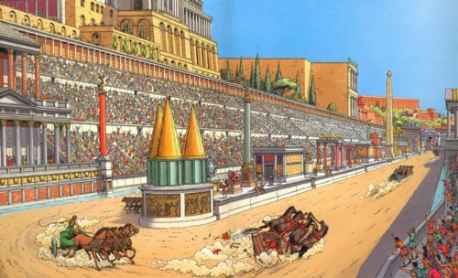
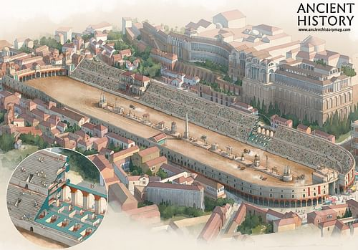
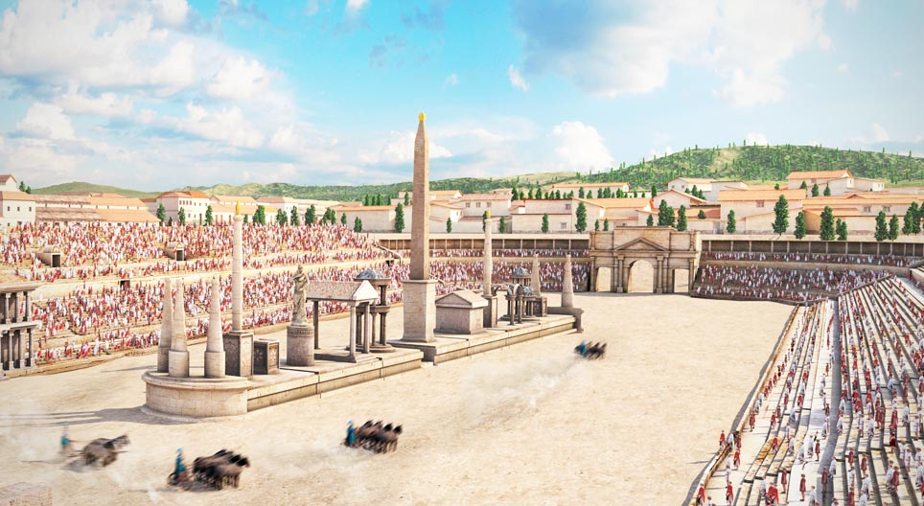
They had finished building the Circus Maximus out of wood, in 80 AD.
Did you know that the Circus Maximus had a younger brother called the Colosseum.
The Circus Maximus is where they play chariot racing.

Slide 3
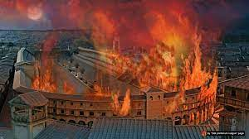
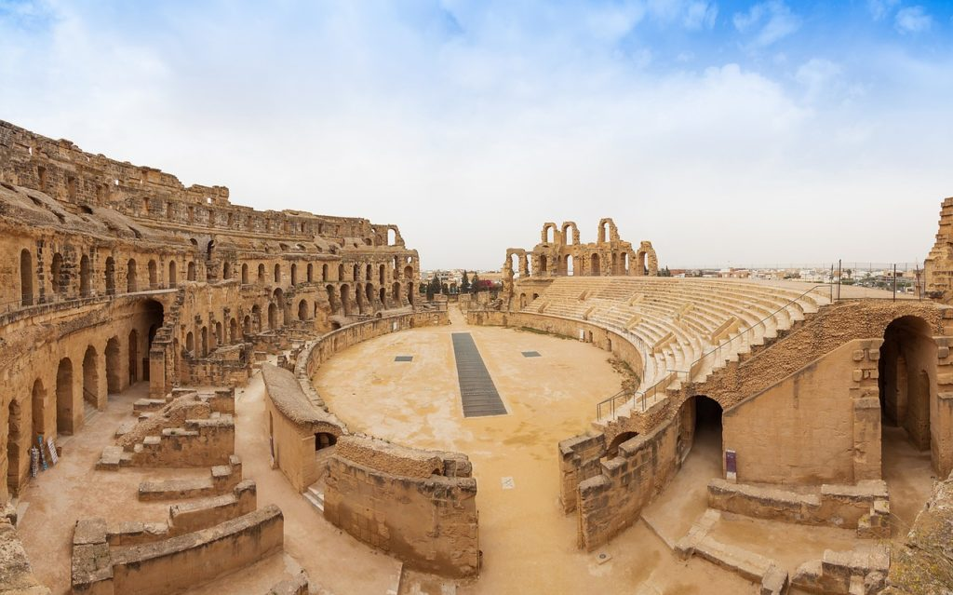
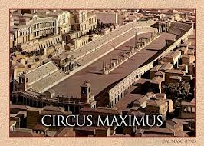
There were 3 fires in the Circus Maximus.
The first one was in 31BC. It was rebuilt again but another fire struck. It was finally rebuilt out of stone and marble, in the first century AD. Likely to avoid further fire and water damage.
Around 50BC Julius Caesar ordered that the seating be extended around the track.

Slide 4
When did the first fire sweep through the Circus Maximus?
31BC
47BC
50BC
31AD

Slide 5

When did the first fire sweep through the Circus Maximus?
31BC
47BC
50BC
31AD

Slide 6
When did the Romans finish building the Circus Maximus?
80BC
80AD
70BC
30AD

Slide 7
When did the Romans finish building the Circus Maximus?
80BC
80AD
70BC
30AD

Slide 8
How many fires were there in the Circus Maximus?
3
2
5
1

Slide 9
How many fires were there in the Circus Maximus?
3
2
5
1

Slide 10
Around when did Julius Caesar order the seating be extended around the track?
72AD
56AD
50BC
40BC

Slide 11
Around when did Julius Caeser order the seating be extended around the track?
72AD
56AD
50BC
40BC

Slide 12
THE END
By Porter White.

