Slide 1
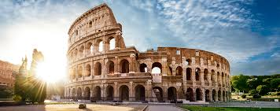
The Colosseum
10 Amazing Facts
by Samuel Pampanella

Slide 2
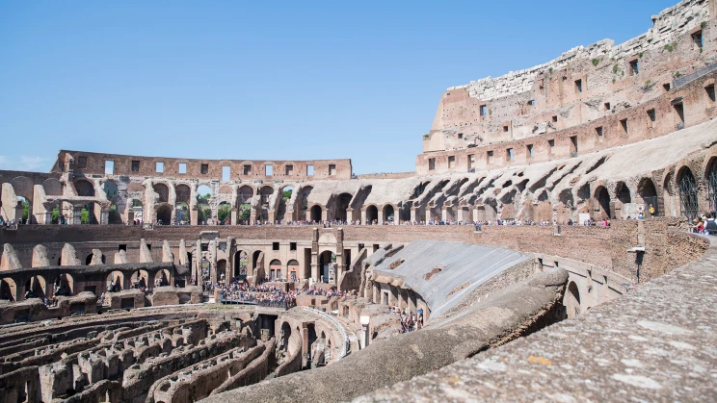
The Colosseum is old
It was completed in 80 AD
It is now 1,942 years old

Slide 3
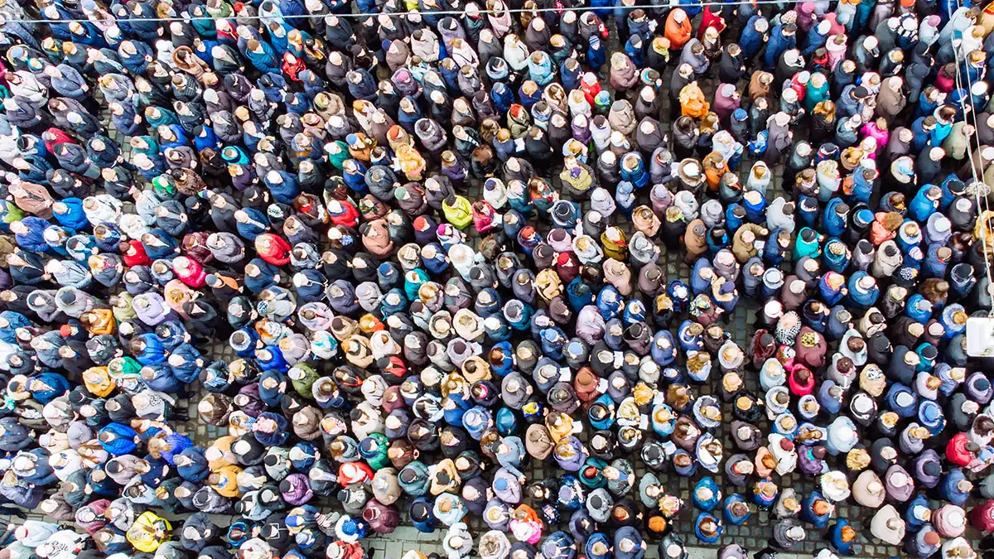
It was HUGE
It could hold a crowd of 80,000 people
That’s 1.5 times more than the population of Brentwood

Slide 4
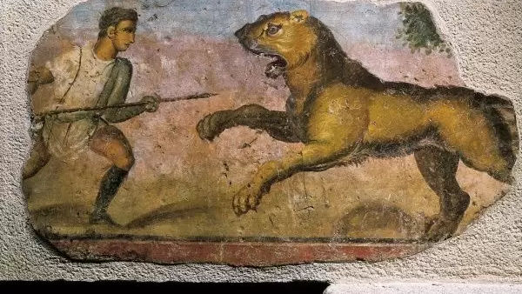
Lots of exciting events happened in there
Gladiator contests
Animal hunts
Re-enactments of famous battles

Slide 5
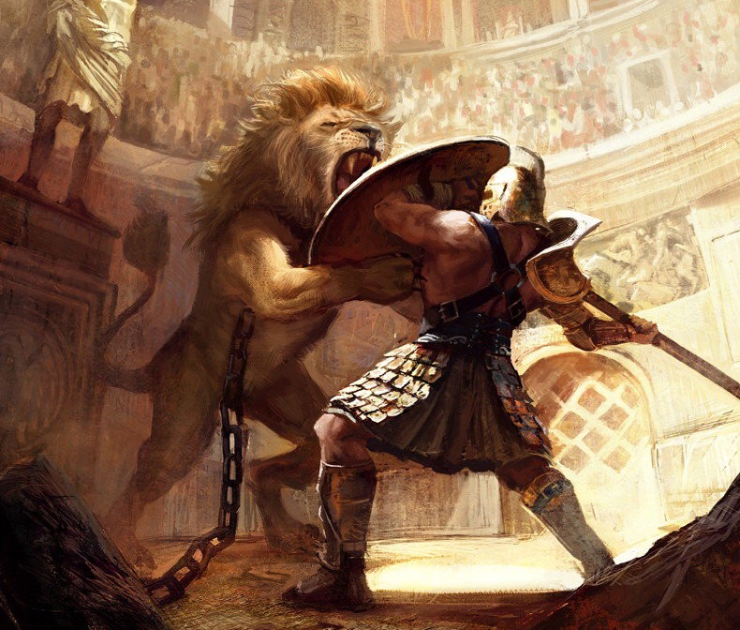
The Gladiators were the stars of the show
They trained for many years
As well as fighting each other they fought lions, tigers and other deadly animals
Men and Women were Gladiators

Slide 6
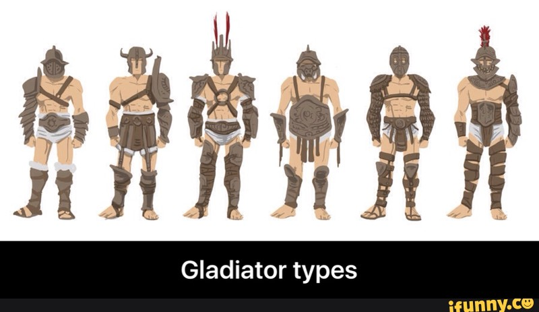
There were many different types of Gladiators
Some examples are:
Andabata - blindfolded gladiator
Bestiarius - beast fighter
Gladiatrix – female gladiator
Eques – Rode a horse in battle

Slide 7
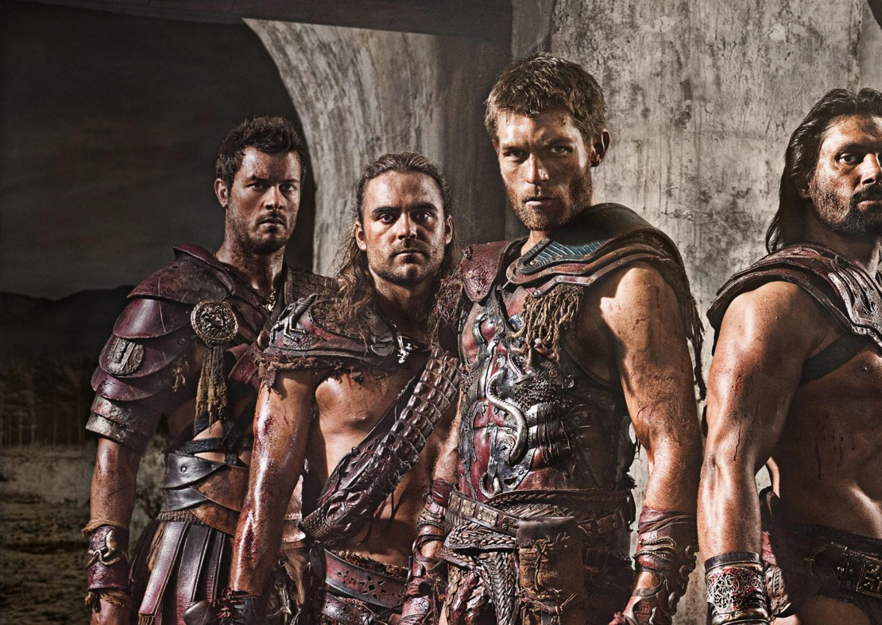
The most famous gladiator was called Spartacus
He was a slave and an amazing gladiator
He escaped from gladiator school with his friends
He beat 6 legions that tried to capture him
Unfortunately, they got him in the end

Slide 8
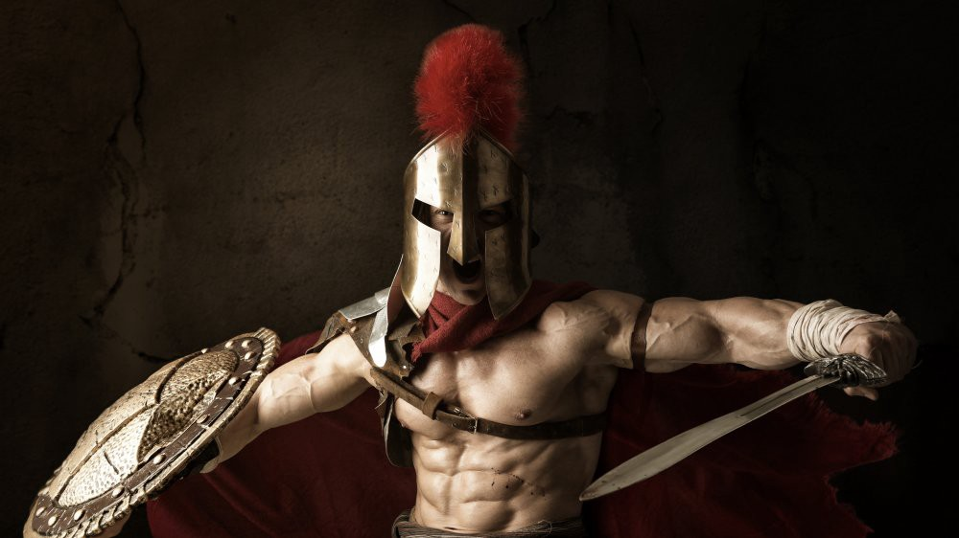
Roman Gladiators were very scary

Slide 9
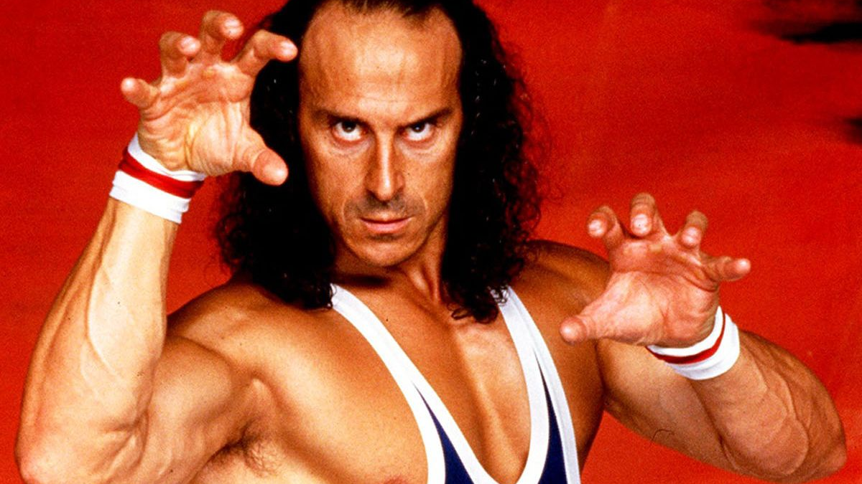
Modern day gladiators just look silly

