Slide 1

Worry Dolls
With all of the changes in the world at the moment and with school, we can all get a little worried.
Today you will think about Guatemalan Worry Dolls and why the children in Guatemala have them.
https://www.youtube.com/watch?v=wjX7qpXp7d8

Slide 2
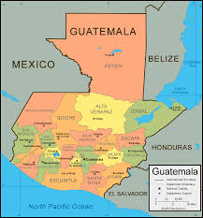



Worry Dolls

Slide 3
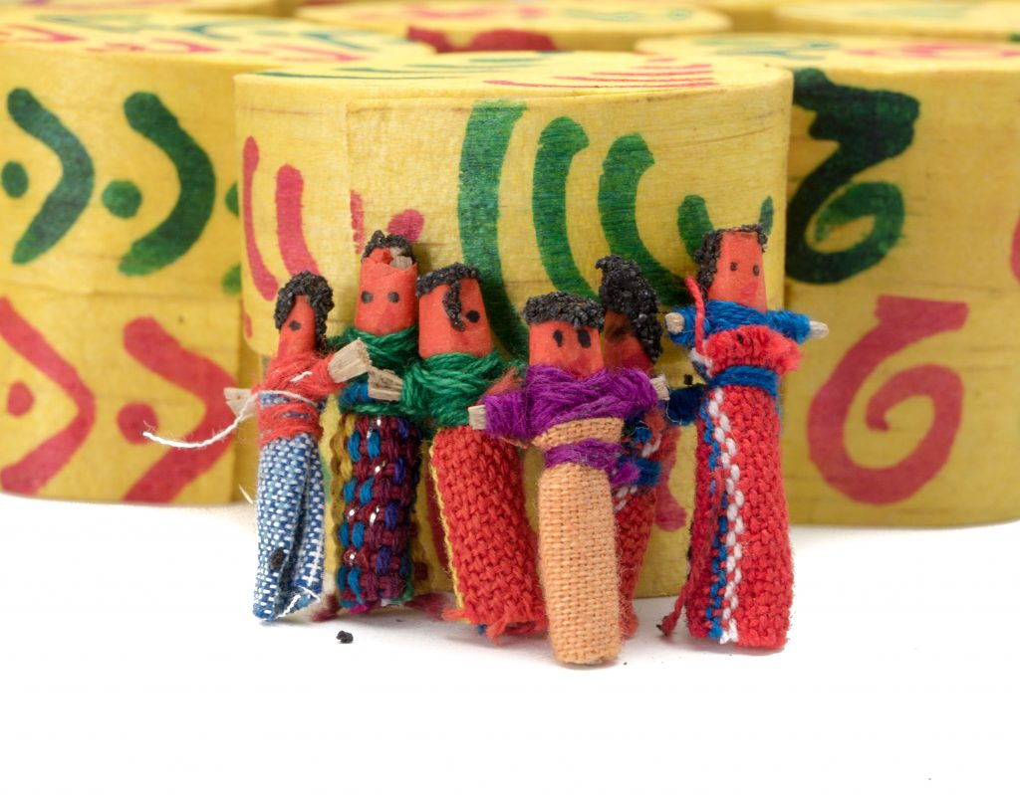
Worry Dolls
Worry dolls are handmade dolls, most often made in Guatemala from wire, wool and small pieces of fabric. The dolls are often tiny, though Western versions can be much larger. Traditionally, the dolls are given to children to help them with their worries. Children will share their concerns with the dolls and then place them under their pillows where the worries will go away over night.

Slide 4
Worry Dolls
To begin…
Do you have any worries?
Have a think about them.
What would help this worry go away?

Slide 5
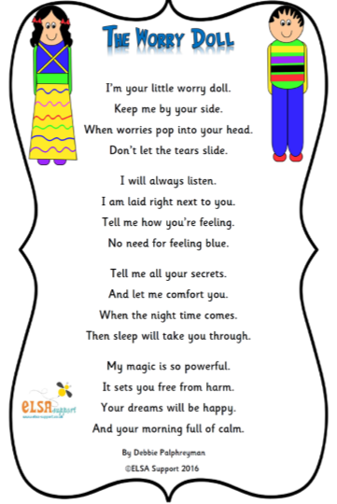

Slide 6
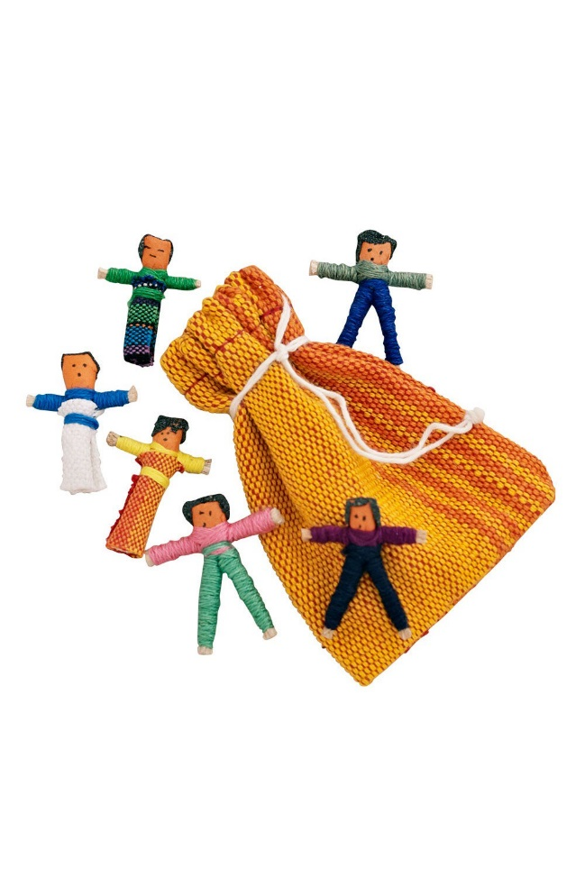
Worry Dolls
Now colour in your own worry dolls.
Take one home and put under the pillow.

