Slide 1
Can I say make a timeline to show oldest to newest toy?

Slide 2
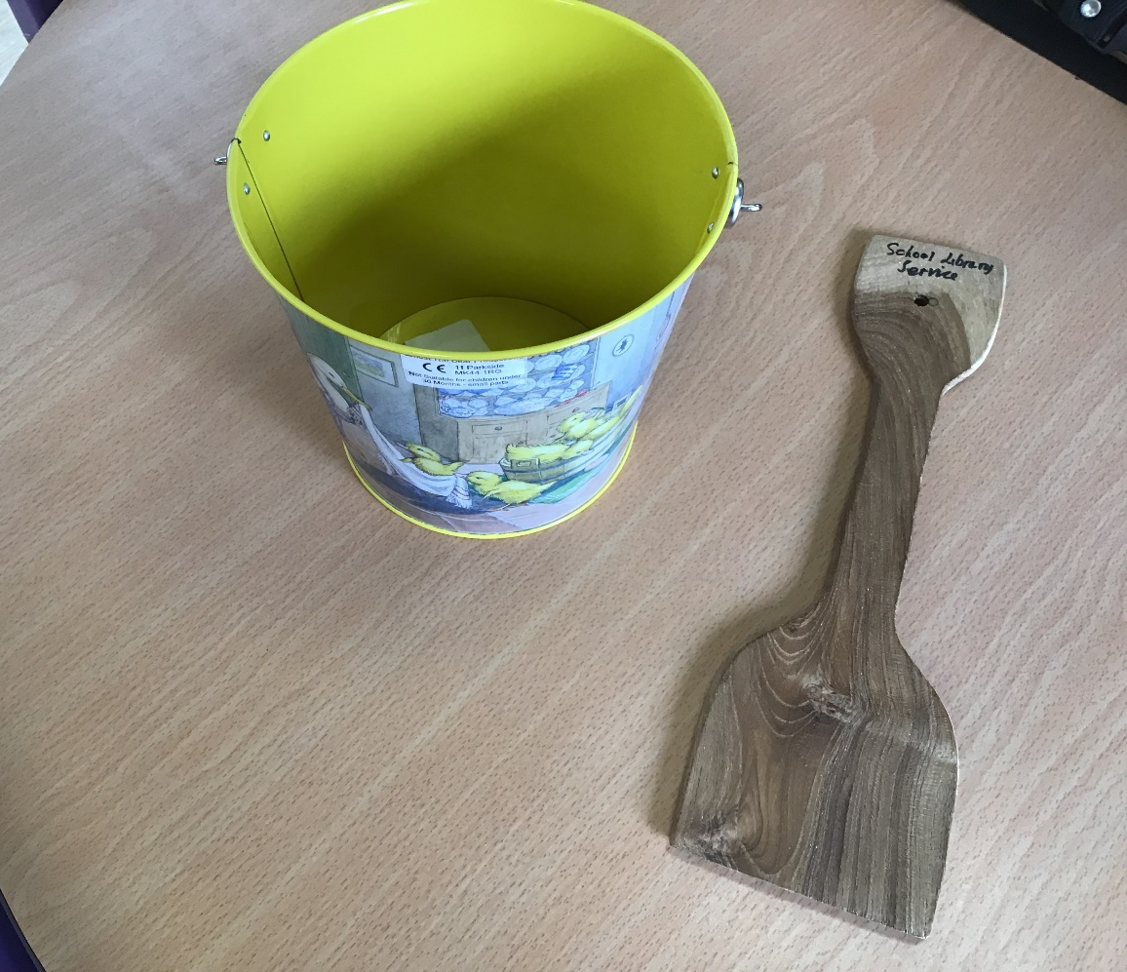
How would you describe the toy?
What is it made from?
Is this toy new or old? How do you know?

Slide 3
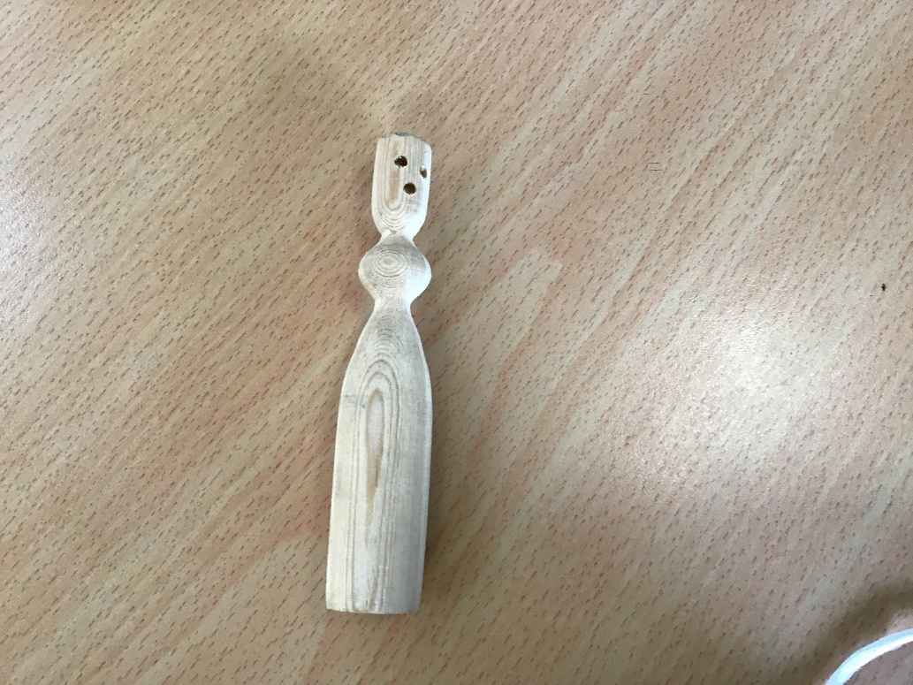
How would you describe the toy?
What is it made of?
Is this toy new or old? How do you know?

Slide 4
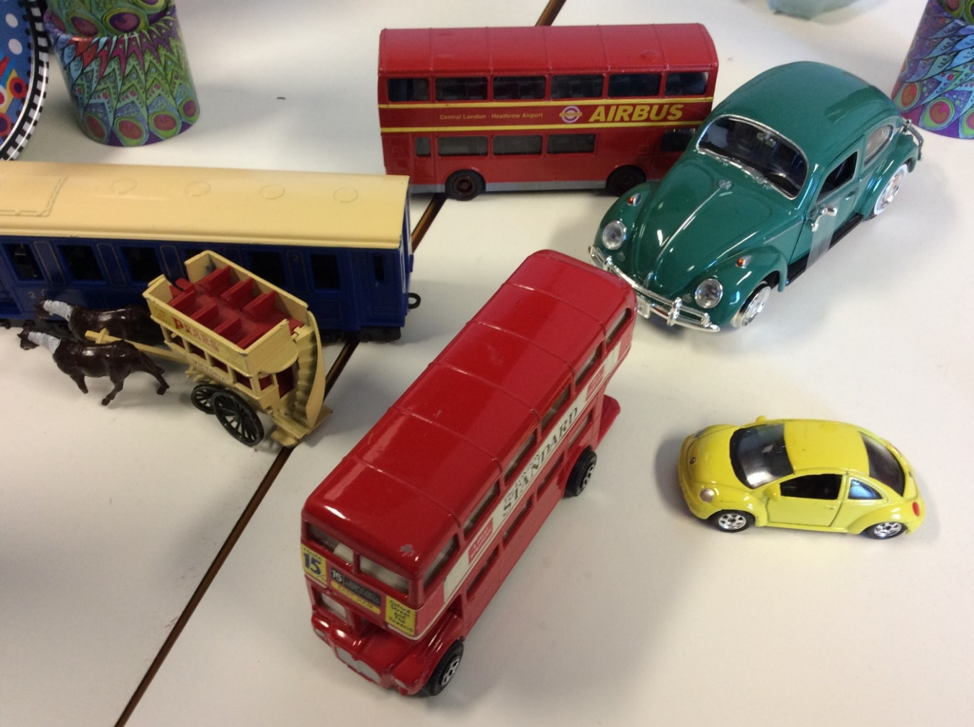
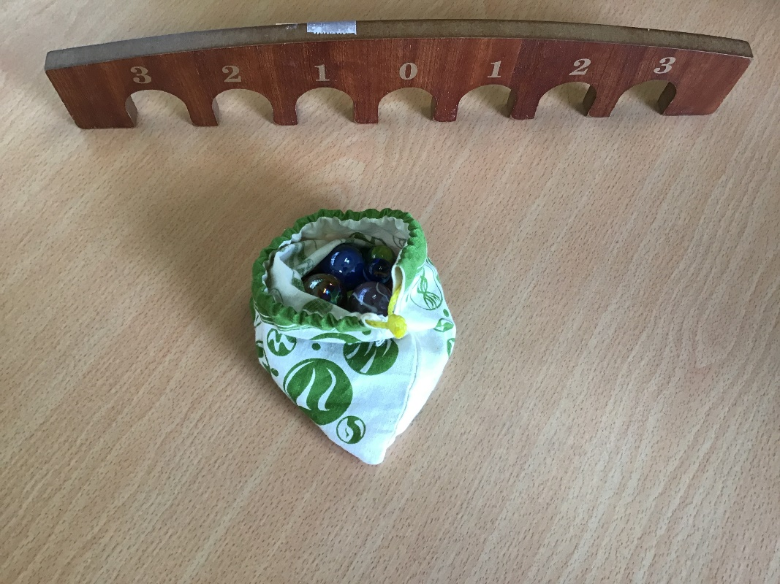
Who might have played with these toys?
Do you think these are old or new toys? Why?

Slide 5
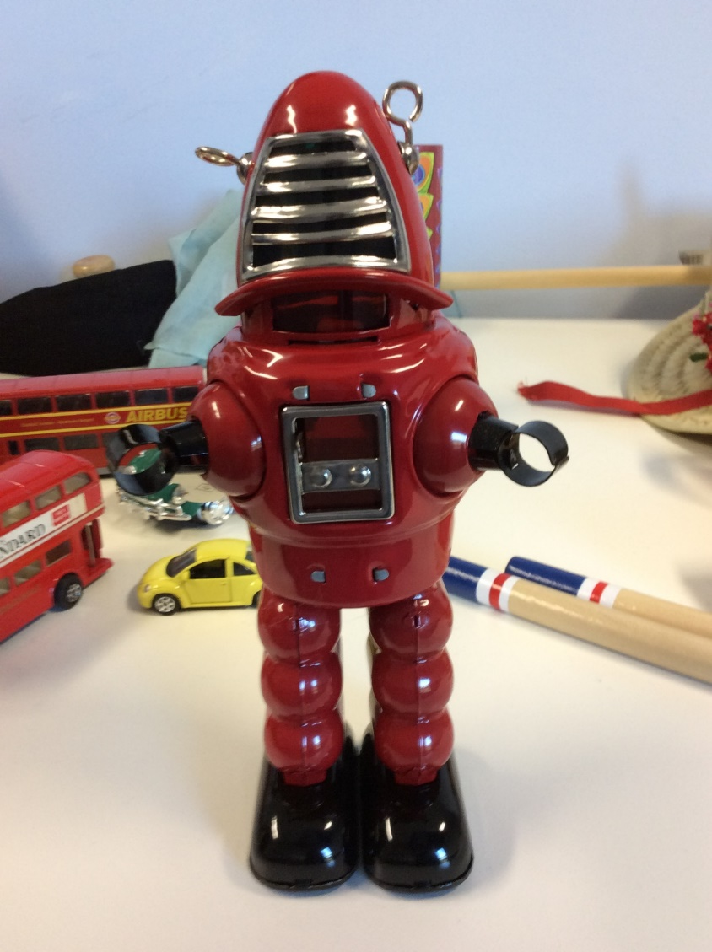
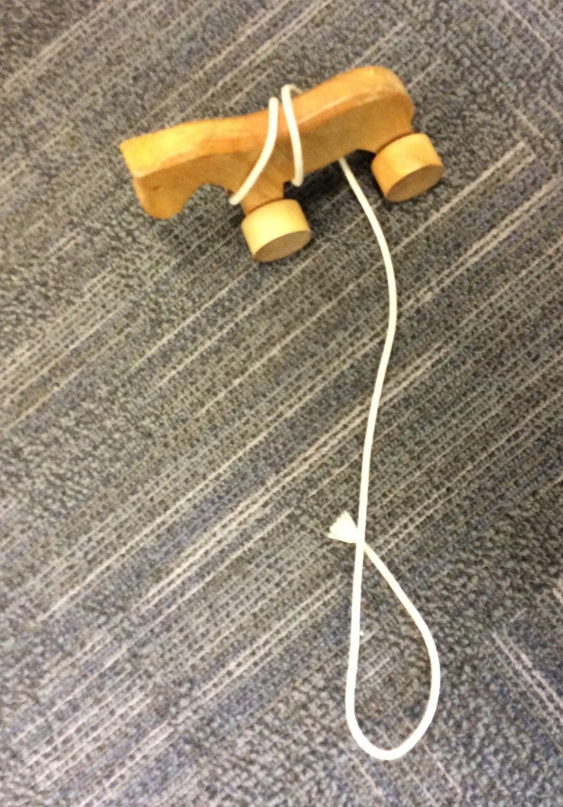
This robot has batteries. Does this mean it is new or old?
Do you think this is newer than the wooden pull along toy or older?
What do you notice about this toy?

Slide 6
How do we know whether a toy is old or new?

