Slide 1
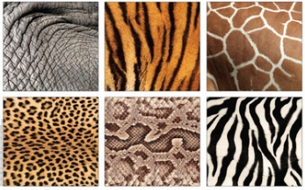


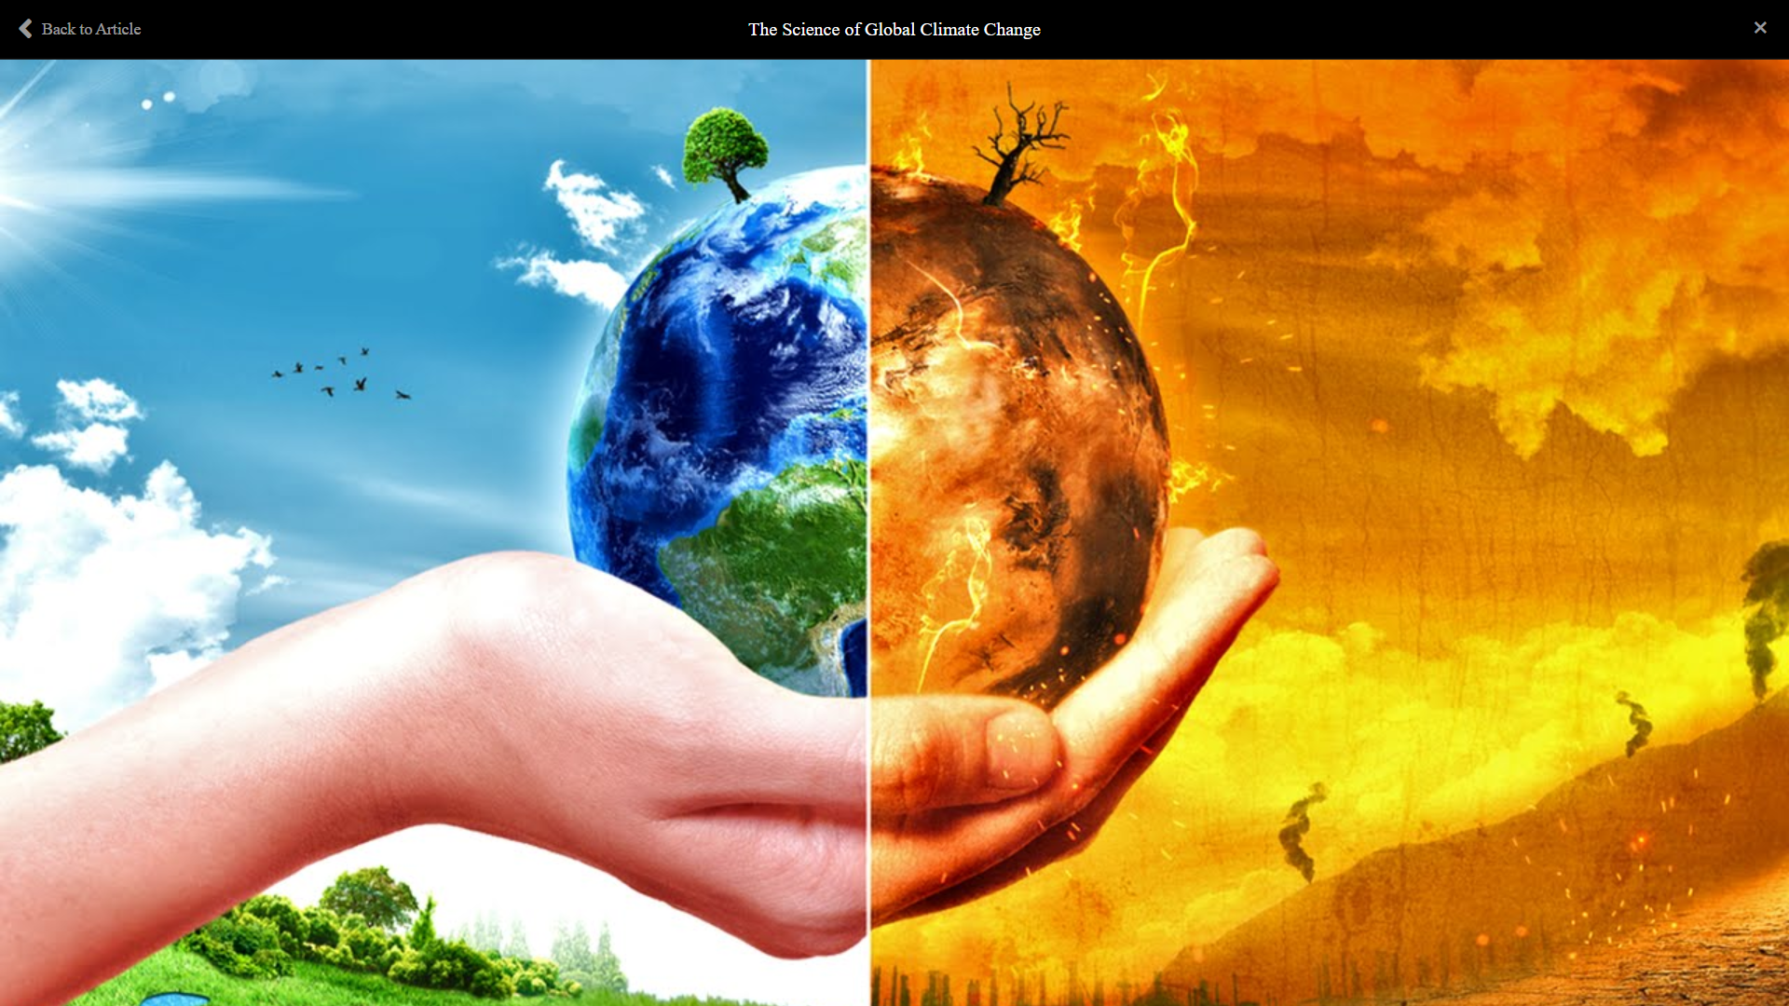

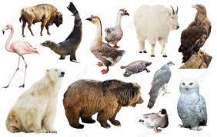
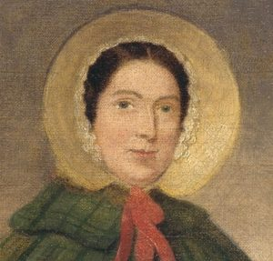
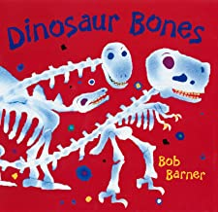
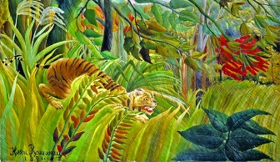

Ladybird and Caterpillar classes will be basing their learning on Amazing Animals. We will experience a range of stories, poems, rhymes and songs about this theme to bring their learning to life.
We will be looking closely at animal patterns and finding out about camouflage!
Ladybird & Caterpillar
Spring Term 1st 2026
Stunning Starter
Marvellous Middle
Fabulous Finish
To finish our topic, we will be having a dinosaur themed day.
Arriving at school to discover our classrooms have turned into jungles!
Our author focus for this half term will be Giles Andreae.
Amazing
Animals
We will find out about climate change and the importance of looking after our planet. We
will also find out about the prominent figure of Greta Thunberg.
As part of our Understanding of the World, we will look at the different habitats of jungle, arctic, desert, savannah where animals live and find out why they are suitable places for those animals to live.
For our
creativity we
will be making
our own Tiger in a Tropical Storm painting, inspired by Rousseau.
We will be finding out about the historical figure of Mary Anning and her discovery of dinosaur fossils. We will then spend a week focussing on dinosaurs.
Personal, Social and Emotional Development. We will continue with our Jigsaw approach to teaching PSED focussing on ‘Dreams and Goals’.
In our Mathematics we will be introducing zero, comparing numbers to 5, composition of 1- 5. Learning the numbers 6, 7, 8. Develop our adding by combining groups and making pairs. Making comparisons in height, length, mass and capacity. The children will learn that time can be measured.
For our Marvellous Middle we will be finding out all about ice.

