Slide 1

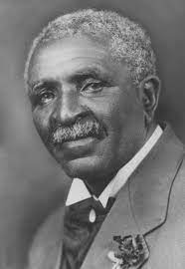

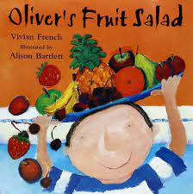
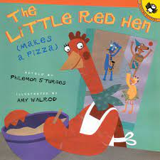
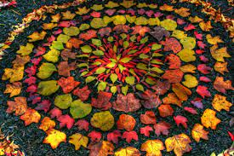

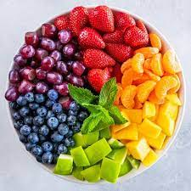
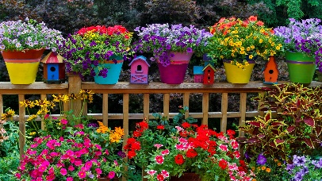
Come Outside
Past and Present
- We will be learning about how farms have changed over the years and looking at George Washington Carver and what he did for farming a long time ago.
Numeracy
– Our focus is on ‘Building 9 & 10’. In this unit the children will be exploring the numbers 9 and 10, how they can be represented, 1 more, 1 less, the composition of 10, number bonds to 10 (both 2 parts and 3 parts), doubling numbers and even & odd. The next unit will be 3-D shapes, recognising, naming them and their properties. This unit also explores more complex patterns.
Spring Term 2 Ladybird and Caterpillar Classes
Stunning Starter
- We will look inside a variety of fruit and vegetables and discuss what we can see
Literacy – We will be sharing a variety of books to help us learn all about plants which grow and how to use them in the food we eat.
Marvellous Middle
- We will be going on a trip to Barleylands farm to see how our food is grown.
People, Culture & Communities – We are looking at how to keep our world a better place to live through recycling.
RE - We will be exploring why ceremonies and festivals in a variety of faiths are important to people. We will ask big questions about what people believe and how this affects the choices they make in their lives.
The Natural World – We will be looking at parts of a plant, the life cycle of a plant and finding out where a plant grows best.
Fantastic Finish
- Going on a bug hunt in our local area. (Children accompanied by a parent).
PSHE – We will be looking at how to keep our bodies healthy. This includes what we eat, why we need sleep, keeping ourselves clean and Stranger Danger.
Creating with materials – we will be exploring colour mixing and making a fruit salad.
Being expressive and Imaginative – We will be creating different sounds using percussion instruments, looking at the artist Andy Goldsworthy and doing some observational drawings of plants.
PE –We will be developing our fundamental movement skills of balancing, running, hopping, jumping, travelling and changing direction.

