Slide 1
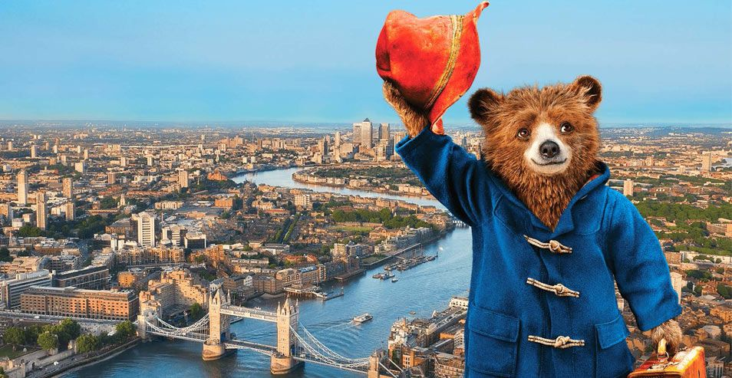
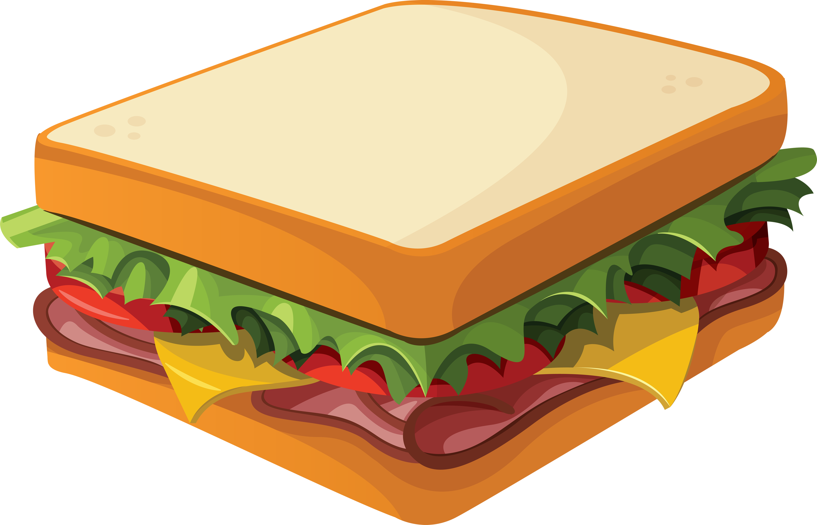

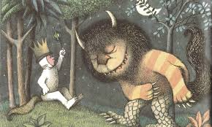

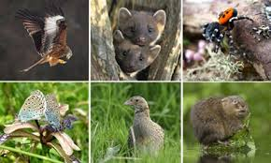
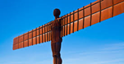

English
We will be reading the Paddington stories, writing postcards and creating our own adventures. We will also be using the story Where the Wild Things Are as a stimulus for writing. The children will complete the term by writing information pages all about London.
Author Focus Michael Bond and Nick Butterworth.
Maths
In our maths this term we will be continuing to use different methods to solve addition and subtraction equations using numbers up to 20. The children will be developing reasoning skills to help solve problems.
We will also be starting to learn about measuring length, mass and volume.
Design and Technology
We will be planning healthy sandwiches for Paddington to try.
RE
We will be exploring Bible stories from the Old and New Testament, as well as learning about the Easter story and associated practices. We will also be learning about symbols, important people and places in other faiths.
Computing
We will be pretending to be chefs and filming steps of how to make a sandwich using iMovie. We will also be using Excel to collect data about our favourite sandwiches.
Science
We will be comparing and identifying different species and naming common animals which are carnivores, herbivores and omnivores, as well as finding out how to classify birds, mammals, insects and reptiles.
We will be investigating climate and the different environments animals live in.
PE
The children will be learning various yoga techniques in our indoor yoga sessions. We will also be focusing on sending and receiving skills to be used within games.
History
We will be looking at famous UK landmarks and how the landscapes have changed through time, as well as exploring how people and industries have had an impact on the world we know today.
Geography
We will focus on Paddington’s home in Darkest Peru, exploring its traditions, landmarks, animals, climate and geographical features whilst comparing it with the UK.
Starfish and Octopus join
Paddington’s Adventures
Spring 2026
Art
Children will be introduced to sculpture and a variety of media. We will make our own clay sculptures of Paddington.
PSHE
Our focus is dreams and goals. We will be setting our own goals and thinking about how we can celebrate our achievements.
We will be thinking about how to keep ourselves healthy through eating, exercise and well-being.
Music
The children will continue to develop their listening, appraising and performing skills through a variety of musical activities.

