Slide 1
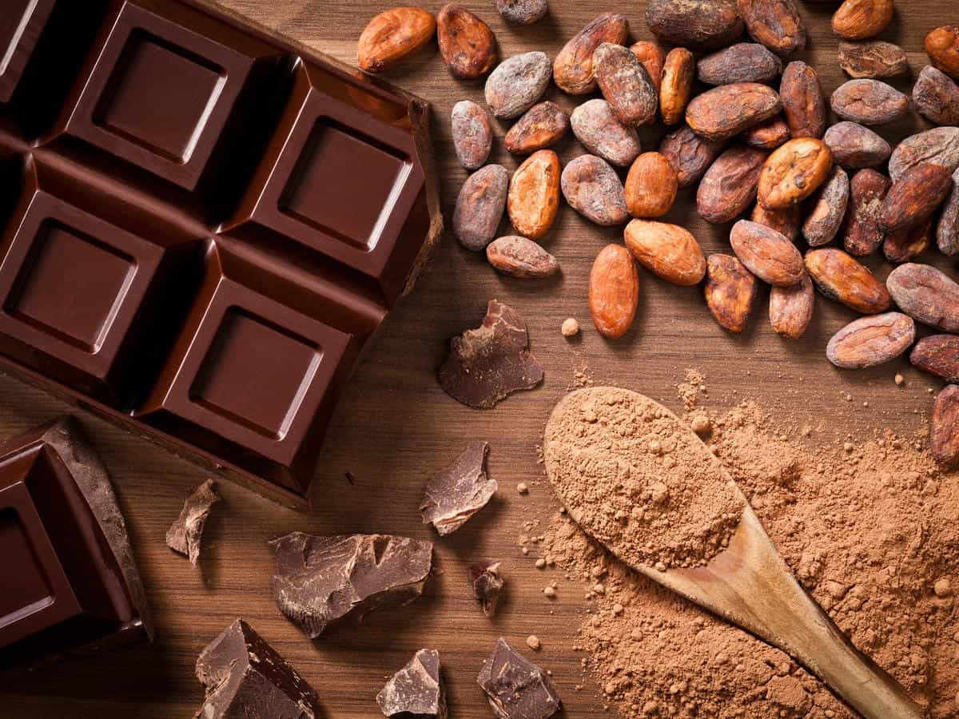
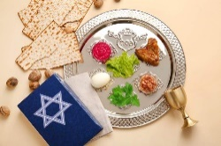
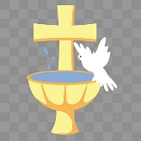
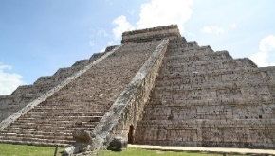
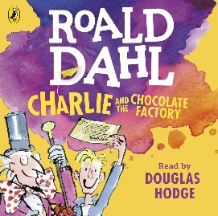
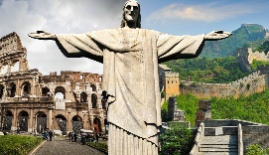
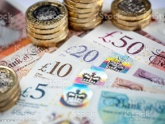

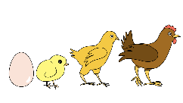
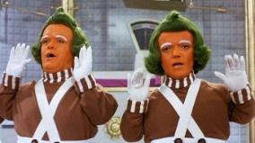
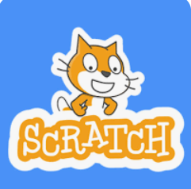
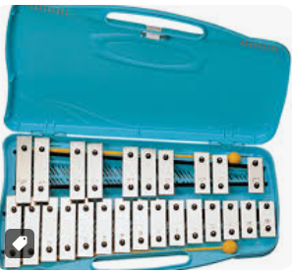
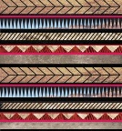
RE
Through a human and social science lens we will be exploring:
How do Christians belong to their faith family?
How do Jewish people celebrate Passover (Pesach)?
Literacy
We will be looking at non fiction writing, learning about the marvellous world of chocolate. We will also be reading Don’t Read this Book! and
Maximus and the Beanstalk, using them to inspire our own writing. We will be focusing on Charlie and Chocolate Factory creating a story based on a new character and room within the factory.
History
We will look at where the Aztecs lived 500 years ago and the origins of the cocoa plant. We will learn the process of making chocolate. We will look at the Ancient Aztecs and their daily life.
PE
We will be practising a range team building skills. We will then look at gymnastic skills through a series of circuits; creating our own sequence of movements. We will also be learning to play a range of invasion games and developing our teamwork with our unit of net and wall games.
Maths
We will be exploring money and learning how to calculate change. We will also focus on multiplication and division, looking at the methods we can use to help us. We will be exploring different types of measure including, length, mass & capacity.
Geography
We will be exploring Why is our world wonderful?
Learning about the world’s wonders, the names and locations of the world’s oceans and considering what is unique about the local area.
CHOCOLATE
Puffin and Moorhen Classes
Spring 2026
PSHE
We will study how to look after our mental and physical health. We will be looking at how medicines help us feel better and how to use them responsibly. We will also be thinking about our own dreams and goals.
Science
We will think about how animals and humans grow. We will find out the basic needs of animals and how exercise is important in keeping us fit.
DT
Following our chocolate theme, we will be creating our mode of transport for the Oompa Loompa’s to get around the chocolate factory.
Computing
Music
We will continue to learn how to play the glockenspiel and compose our own music.
Art
We will create a range of our own art pieces, in the style of the Aztecs. We will be exploring different print making techniques.
We will be learning how to use the programme Scratch to create a game using coding.

