Slide 1


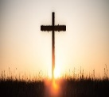
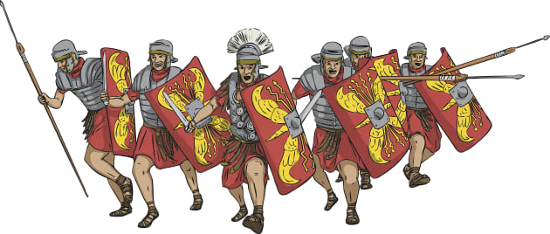


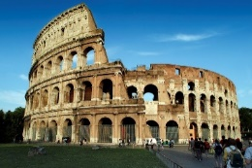
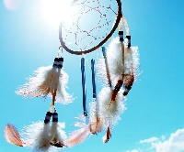

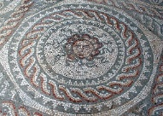

The Rampaging Romans
Literacy
We are linking our Literacy to our Romans topic. We are writing a narrative on chariot racing and an information text on gladiators.
Science
‘Mirror, Mirror’ and ‘Opposites Attract’ are our topics for science. We look at mirrors and magnets, respectively.
RE
How do people make moral decisions? We look at moral dilemmas and the impact of our decisions on others.
Why do Christians call the day Jesus died ‘Good Friday?
Maths
Year 3 will be studying a range of topics this term, including fractions, mass and capacity and perimeter.
PE
Year 3 will be focusing on fitness and dodgeball (indoor PE) and basketball and tennis (outdoor PE).
Dolphin and Penguin Classes Spring Term 2026
Humanities
The Rampaging Romans. We are studying life as a Roman, gladiators, chariot races, famous buildings and what the Romans did for us.
In geography, we will be learning about Antarctica.
Music
This term we will be learning to use tuned instruments working with the song “Three Little Birds” by Bob Marley.
We will also be improvising using the song “Let Your Spirit Fly”.
Art and DT
In Art, the children will be designing and creating their own mosaics from clay. In DT, the children will be using pneumatics with a Roman theme.
Computing
Our unit for this term ‘We are presenters’ focuses on sports presenting of chariot races. We will also be looking at common signs of programming errors.
PSHE
As a school, we are following a PSHE curriculum called ‘Jigsaw.’ Our units are called ‘Healthy Me’ and ‘Dreams and Goals.’

