Slide 1
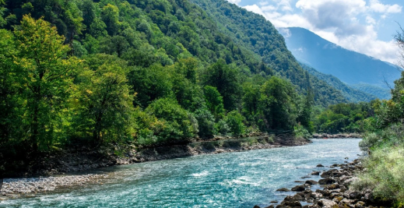
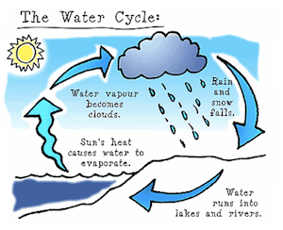
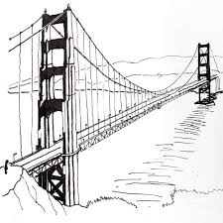
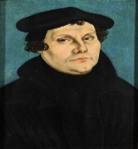


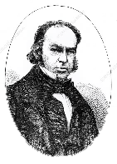
Mathematics: We will be looking at multiplication/division, understanding fractions and decimals . We will also be measuring area using standard units.
English:
We will be looking at stories set in imaginary worlds and non-chronological reports. We will explore a range of poems and perform a choral reading.
PSHE:
We will look at the unit “Dreams and Goals” when we will reflect on how positive and happy experiences help us cope with disappointment.
Our unit on “Healthy Me” will discuss peer pressure and making decisions.
Computing:
We will use weather collecting resources to input the data into an Excel spreadsheet and record using graphs. Then, as meteorologists we will create our own spreadsheet to record the information about the weather in Shenfield.
Go with the flow
Geography:
Amazing Alps will be our initial focus. We will be looking at the physical and human characteristics of the Alps, leading into comparison with our local environment.
After half term, we will be investigating the water cycle and identifying features of a river
We will also be developing our map work skills. We will learn about the impact of how we live on the environment .
Woodpecker and Sparrowhawk classes
Spring 2026
History:
We will study the lives of significant individuals in the past who have contributed to national and international achievements e.g. Brunel
Music: We will focus on comparing songs, giving reasons for opinions. Then, we will listen and appreciate a range of soul and gospel music.
PE: Our new units will focus on Yoga & Tennis. Cross country tasks also feature this term.
DT: Bridges will be our focus area, looking at the different types and their features before designing and making our own bridges to test and evaluate.
Art: We will study the artist William Morris and investigate print-making techniques. We will explore combining and organising shapes, colours and patterns.
RE:
In RE, we will be investigating how religious groups contribute to society and culture. We will also be exploring the diversity of belief in Christianity.
Science:
As scientists we will be looking at states of matter, making careful observations and comparisons between materials in different states. We will be investigating evaporation and condensation.

Slide 2


