Slide 1
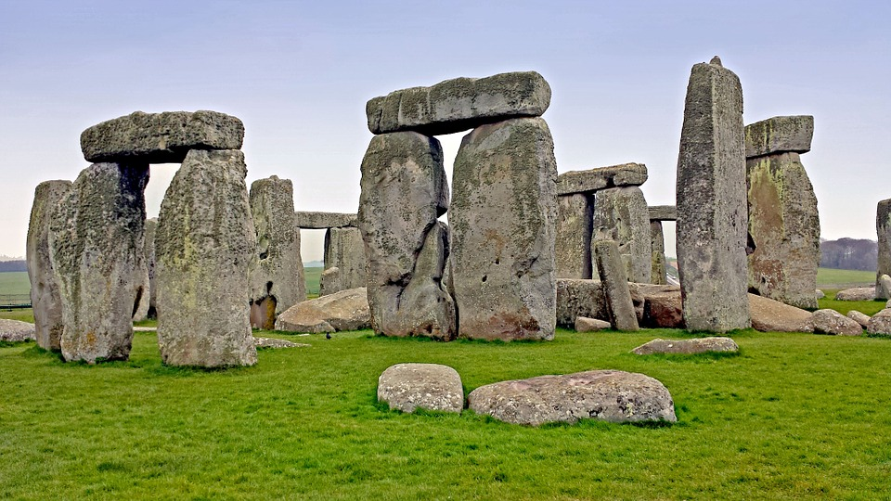



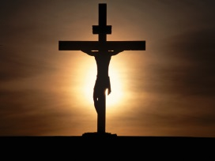


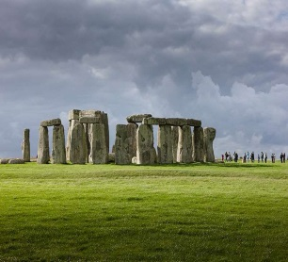



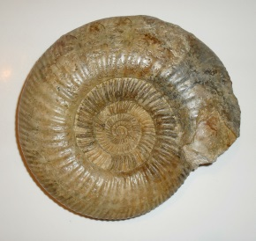
STIG OF THE DUMP
Maths
We will be working on a wide range of skills, including multiplication, division, decimals and fractions, and applying them to reasoning activities.
Music
The children will develop their skills with the recorder and glockenspiel following the Charanga scheme. Year five will also be preparing and leading the Easter service.
RE
The children will be looking through the philosophy lens at the meaning of life. They will then look through the theology lens at the importance of the resurrection.
PE
We will be developing our tennis and football skills. We will also be studying dance and gymnastics too!
Literacy
We will be learning how to write a persuasive argument, using the theme of ‘Healthy Me.’ We will also explore classic/narrative poetry, as well as looking at traditional stories, myths and legends.
Otter and Water Vole Spring Term 2026
PSHE
We will be comparing our goals with other cultures. We will learn how to keep ourselves safe, as well as fit and healthy.
History/Geography
We will be looking at The Stone Age, as well as journeying to The Bronze and Iron Ages.
Computing
We will become game developers using Scratch to design and write our own games.
Science
We will be developing our investigation skills through studying the Material World.
Art
We will look at Stone Age cave paintings to inspire our own versions.
DT
We are creating prehistoric house from natural materials.

