Slide 1
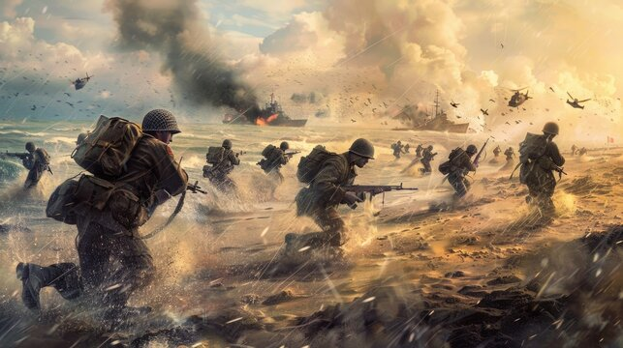
Maths
We will be looking at decimals, percentages and algebra before half term, as well as perimeter, area, volume and ratio up to Easter. We will continue developing problem solving techniques throughout these topics.
Art
We will develop an understanding of photography in the context of World War 2. We will create a photo gallery showing the development of skills and considering shape and form.
Science
Our Staying Alive work will focus on how the body works and how we can keep it healthy. We will also look at classification and how animals and plants are organised.
Music
We will start to identify jazz and blues music. We will compose and perform music and compare the different features of music.
PE
In PE we will be creating a personal fitness regime and improving our tennis skills.
RE
We have a busy term looking through the philosophy lens, answering the question, ‘What does it mean to be human?’. After half term, we will be looking through the theology lens and studying whether science and creation are conflicting or complementary ideas.
WORLD WAR II
Badger and Pine Marten Class
SPRING 2026
Geography
We will be identifying the extent of the countries involved in WW2. We will consider the effect of the war on supply and demand and the need for rationing as well as identifying which places within the UK were most at risk. We will also be looking at where energy comes from.
Computing
Like Turing, we will study the world of codes and use ciphers to crack them! We will then link this to how we can keep ourselves safe in today’s world of computers. We will then look at different types of searches in order to become computational thinkers.
French
We will be developing our conversational skills on the topic of ‘Where I live’. This will include using vocabulary to describe different buildings and rooms as well as adjectives and prepositions.
History
Our topic will address questions surrounding WWII and consider the impact on local people and life as an evacuee.
PSHE
Our themes will be Dreams and Goals: learning to persevere and be the best that we can be and Healthy Me: developing an understanding of healthy living.
Literacy
We will be studying poetry before moving onto creating narratives with effective flashbacks. The children will write a recount of their visit Duxford.

